Slide 1
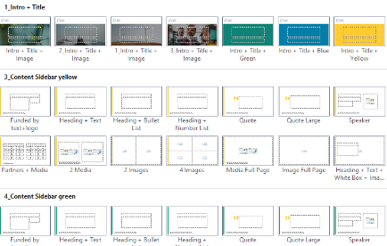




User guide – delete before use
Swedish Life Cycle Center PPT template consist of 7 layout templates divided into intro, five diffrent coloured content and extro.
The idea of the coloured content templates is that you change colour when you present a new category/theme.
Use layouts
1. Click the home tab
2. Click the ”New slide” menu to insert new slide
3. Choose ”Layout” to pick a appropriate layout from the drop down menu
Copy/paste
If you choose to copy content or slides from another PPT-presentation, always make
sure you paste the content unformatted to keep the design of this template.
1. Click the home tab
2. Choose the arrow in the paste menu to find the drop down menu
3. Pick ”use destination theme” if you paste an entire slide page
4. Pick use ”keep text only” if you paste text content
Reset slide
If you by mistake change the original design of the template you can always reset your slide.
1. Click the home tab
2. Click the reset menu to reset position, size and formatting of the slide placeholder to their default settings

Slide 2
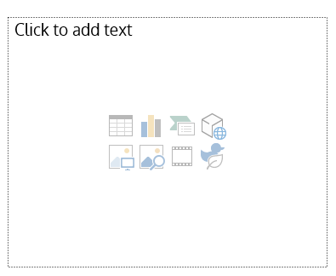

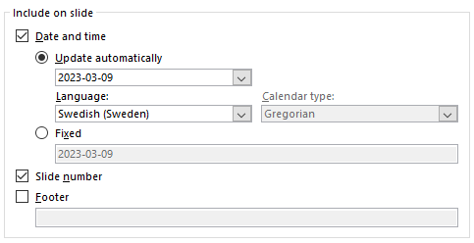
User guide – delete before use
Insert picture/media
On slides with picture/media placeholder, click on the placeholder and the type of media you want to insert
(for example: picture, chart, smartart, video).
  1. Choose the media you want and click ”insert” or ”ok”
  2. The media will now fill the placeholder area automatically. But if you want to scale the picture for instance,
  hold SHIFT-key down while dragging the corners of the picture
Change slide number and date
The footer in this template is automatic, so it will give a slide number chronologically and show todays date.
If you want to make any changes to the footer do this at the very end of creating your presentation so that the
changes will apply to all slides in the presentation.
1. Click the insert tab
2. Click on Header & Footer
3. Check the box ”date and time” and choose ”fixed” and write the desired date to set a future date
4. Uncheck the box ”side number” if you want to remove the page numbering
5. Click ”apply to all” to make the changes for the entire presentation or click ”apply” to make the change for a single slide

Slide 3
Subject/title
Subtitle, more info or date

Slide 4
Disposition
Title
Title (can be linked within the presentation)
Title

Slide 5

Title
Text here

Slide 6
Title
More info
Bullet points
Bullet points
Bullet points
For more information about the Center, see operational plan, stage 10.

Slide 7
Funded by
Text here, logo in the picture area

Slide 8
More information
Project/research/article
web pages
https://www.lifecyclecenter.se

Slide 9
Contact
lifecyclecenter@chalmers.se
www.lifecyclecenter.se

