Slide 1
We aim for credible & applied life cycle thinking globally!

Slide 2
About us
Swedish Life Cycle Center is a Center of excellence and collaboration platform for academia, research institutes, industry and government agencies.
The Center fosters competence-building and knowledge exchange in advancing and applying the life cycle field.
Notes:
Swedish Life Cycle Center is a center of excellence for the advance of applied life cycle thinking, founded in 1996 at Chalmers University of Technology
The center acts as a meeting place for industry, universities, government agencies, research institutes to do research, capacity building activities to move the life cycle field forward!
working towards our vision: Credible & applied life cycle thinking globally
-------
Credible = Scientific based knowledge
Applied = relevant and useful results (tools, data, methods, practices) developed in collaboration between researchers and practitioners & decision makers
Globally = The life cycle perspective spans across the globe, the products and resources move across national borders. Important to work globally to work for a common methodology development, international harmonization, and together with other research communities etc.

Slide 3
Partners

Slide 4
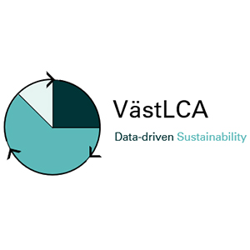
In collaboration with

Slide 5
Core values and principles
A neutral platform for cross-sector solutions
Transparency
& trust
A global perspective
Scientific
base

Slide 6
Our way of working
Engage
Implement
Collaborate
Educate
Share
Notes:
It is all about moving the life cycle field forward -
Our mission is to engage organizations and actors to implement LCT into processes and decision making, in research, in business, among public authorities, and in the rest of society.
But what Is then needed: collaboration and more collaborative research, collaborative forums for dialogue between experts and for mutual learning – we need networking and communication activities.
These have resulted in:
New methods, tools, data and common practices
Education & training for professionals but also in higher education
Strategic intelligence (from business, policy, research perspectives)
A lot of Inspiration & engagement for our network
Global Impact & harmonization in methodology development, working practices, policies etc.

Slide 7
500 + life cycle professionals in the network

Slide 8
This is a value-adding partnership
Capability and capacity building
Network
Joint efforts

Slide 9
Swedish Life Cycle Center sees beyond national and industrial borders. With its unique working groups, the Center can affect the international development in the life cycle field.”
- Elin Eriksson, IVL Swedish Environmental Research Institute

Slide 10
With a lot of competence gathered in one network we can easier reach out with new research solutions and life cycle knowledge.”
- Susanna Widstrand, Swedish Energy Agency

Slide 11
The network has supported in many issues. When we discussed purchasing a new software solution for LCA, the Center’s partners were there to give advice and share experience.”
- Anna Widerberg, Volvo Cars

Slide 12
Thank you!
Anna Wikström lifecyclecenter@chalmers.se
www.lifecyclecenter.se

