Slide 1
Swedish Life Cycle Center is a center of excellence for the advance of applied life cycle thinking in industry and other parts of society

Slide 2
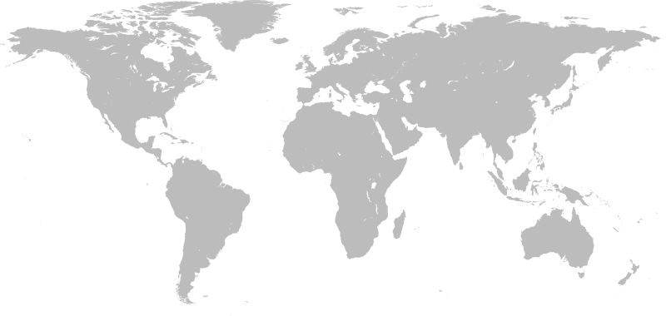
We aim for credible & applied life cycle thinking globally!
Notes:
Swedish Life Cycle Center is a center of excellence for the advance of applied life cycle thinking, founded in 1996 at Chalmers University of Technology
The center acts as a meeting place for industry, universities, government agencies, research institutes to do research, capacity building activities to move the life cycle field forward!
working towards our vision: Credible & applied life cycle thinking globally
-------
Credible = Scientific based knowledge
Applied = relevant and useful results (tools, data, methods, practices) developed in collaboration between researchers and practitioners & decision makers
Globally = The life cycle perspective spans across the globe, the products and resources move across national borders. Important to work globally to work for a common methodology development, international harmonization, and together with other research communities etc.

Slide 3
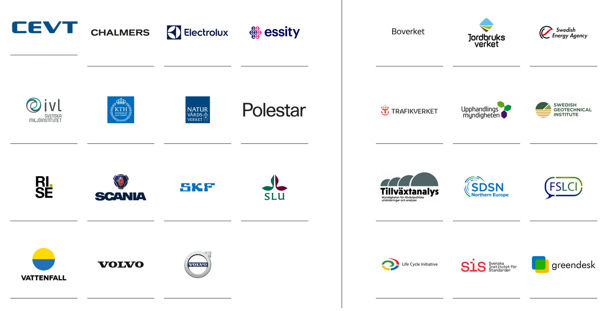
Partners
Notes:
As you can see on the left side - The Center consists of 15 partners from universities, research institutes, industries and one government agency
We are a partner driven center, meaning that it is our partners that sets the agenda and runs all activities, and a technical secretariat that creates the best conditions for our partners to collaborate in.
Over 500 life cycle professionals in the partner network, involved in the center in different ways
An on the right side you will see the government agencies that have a formilized collaboration with the center consisting of almost 50 professionals. And here you will also see other important organizations that we have a formal collaboration with.

Slide 4
Core values and principles
A neutral platform for cross-sector solutions
Transparency
& trust
A global perspective
Scientific
base

Slide 5
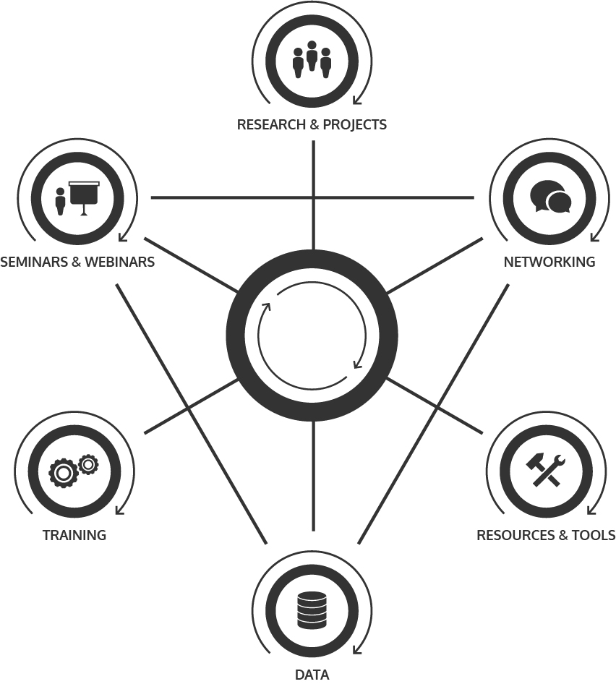
Our ways of work
Notes:
It is all about moving the life cycle field forward -
Our mission is to engage organizations and actors to implement LCT into processes and decision making, in research, in business, among public authorities, and in the rest of society.
But what Is then needed: collaboration and more collaborative research, collaborative forums for dialogue between experts and for mutual learning – we need networking and communication activities.
These have resulted in:
New methods, tools, data and common practices
Education & training for professionals but also in higher education
Strategic intelligence (from business, policy, research perspectives)
A lot of Inspiration & engagement for our network
Global Impact & harmonization in methodology development, working practices, policies etc.

Slide 6
>500
life cycle professionals in the network

Slide 7
A value-adding partnership
Obtain tools and inspiration for new strategies and working processes to implement in your operations.
Benchmark the partners within the center.
Collaborate in joint research projects with academia, research institutes and partners in industry and authorities involved.
Increase your knowledge through close contact with other experts within the life cycle field.
Be highlighted as a frontrunner in sustainability. Your good examples, research or initiatives are communicated in the channels of Swedish Life Cycle Center.
Obtain access to high quality decision support and a network of over 400 life cycle professionals.
Get involved in strategic development through your seat on the center Board.
Find new ways to manage long-term sustainability.
Use the web forum for close contact with partners.
Make a larger impact through joint efforts to influence national and international initiatives.

Slide 8
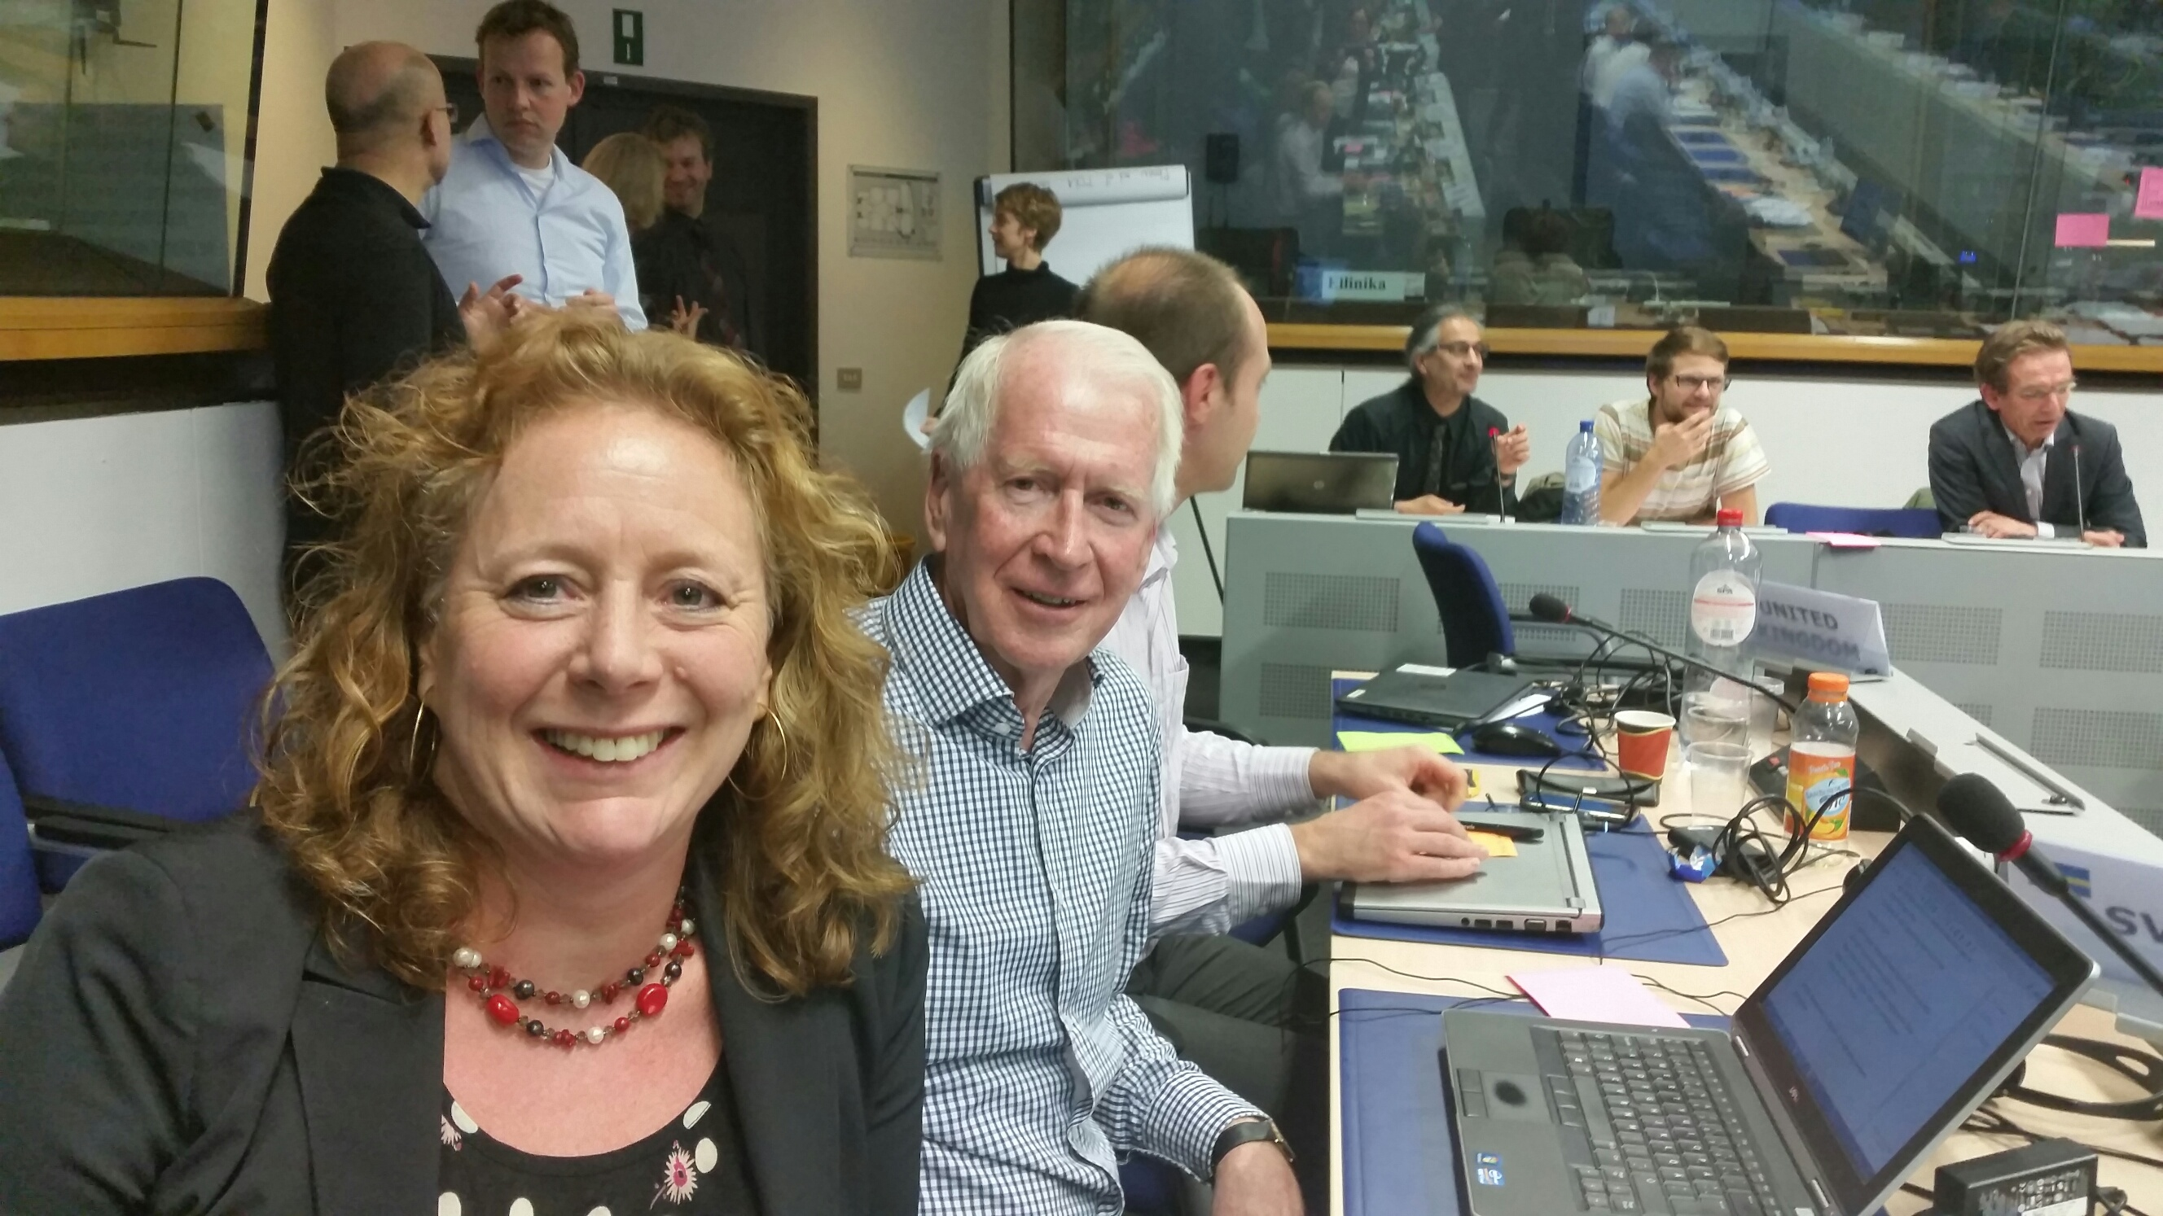
“Swedish Life Cycle Center sees beyond national and industrial borders. With its unique working groups, the center can affect the international development in the life cycle field.”
- Elin Eriksson, IVL Swedish Environmental Research Institute

Slide 9
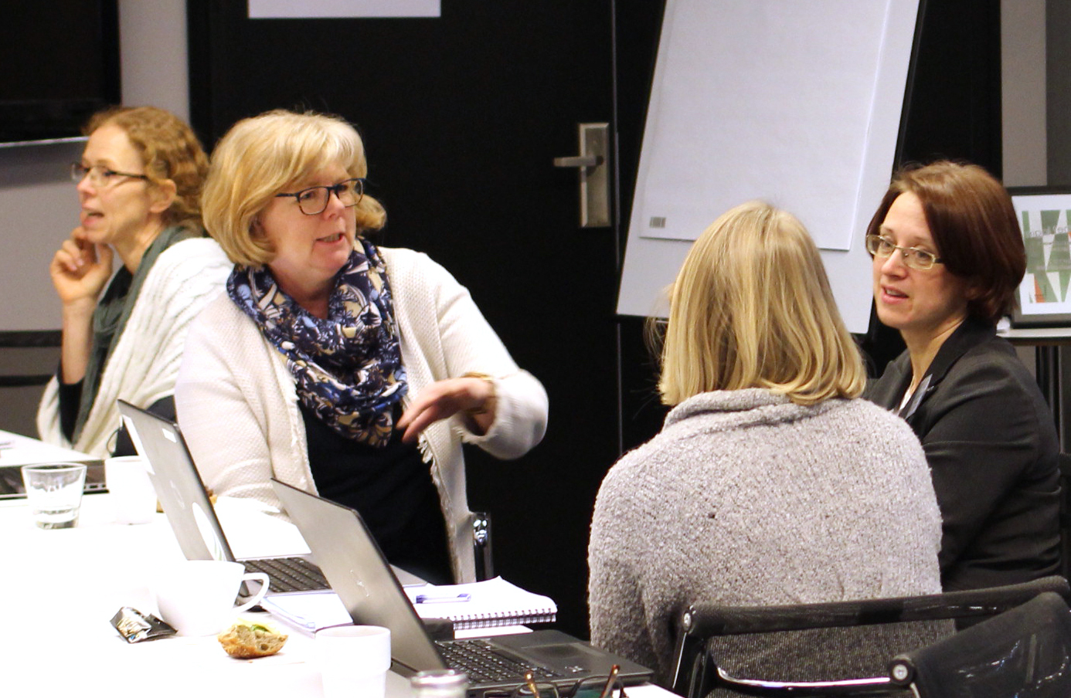
“With a lot of competence gathered in one network we can easier reach out with new research solutions and life cycle knowledge.”
- Susanna Widstrand, Swedish Energy Agency

Slide 10
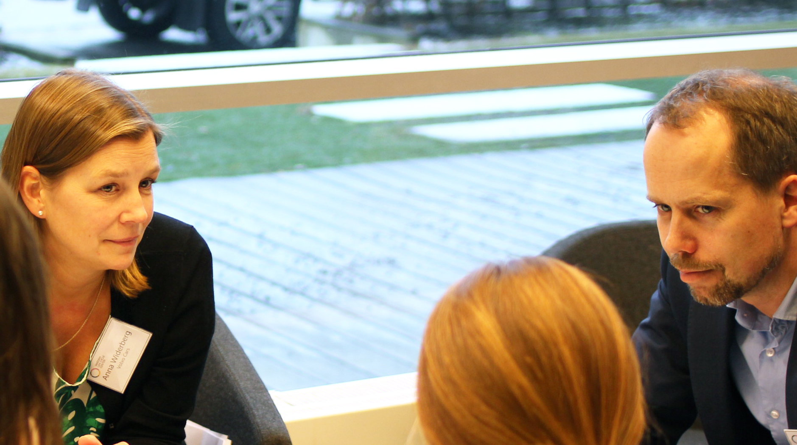
“The network has supported in many issues. When we discussed purchasing a new software solution for LCA, the center’s partners were there to give advice and share experience.”
Anna Widerberg, Volvo Cars

Slide 11
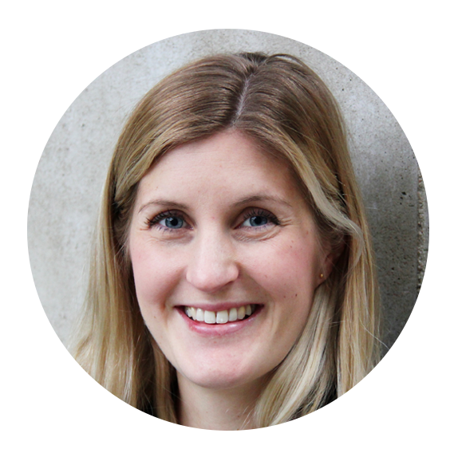
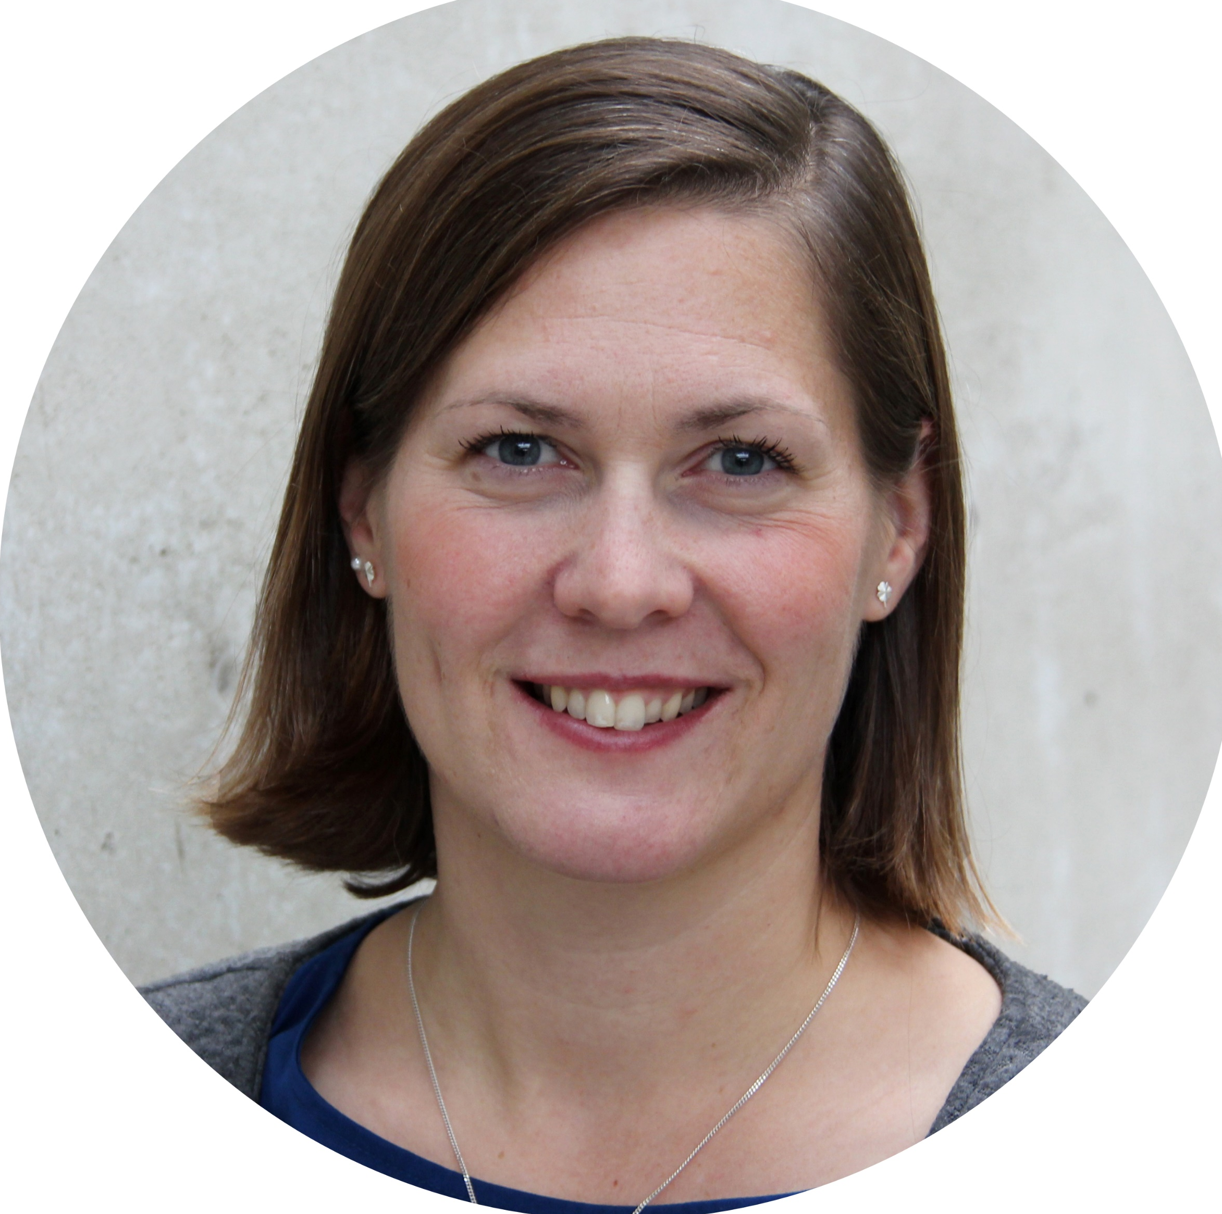
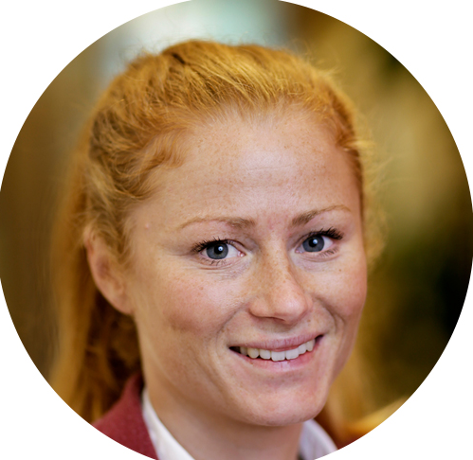
Thank you!
www.lifecyclecenter.se
Twitter: @lifecyclecenter
LinkedIn: Swedish Life Cycle Center
Director
Sara.palander@chalmers.se
Project manager (parental leave)
Anna.wikstrom@chalmers.se
Project Manager
Maria.rydberg@chalmers.se

