Slide 1
Swedish Life Cycle Center is a center of excellence for the advance of applied life cycle thinking in industry and other parts of society

Slide 2
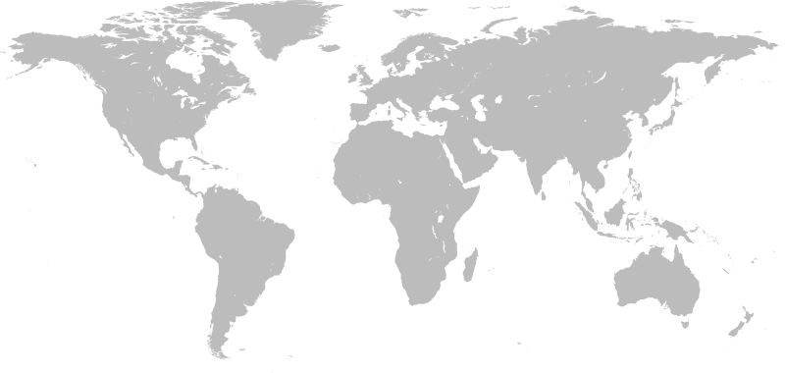
We aim for credible & applied life cycle thinking globally!

Slide 3
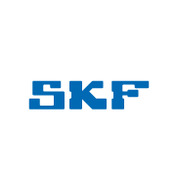
A partner driven center
Boverket
14 partners and 7 government agencies in collaboration

Slide 4
Short facts about us:
14
24
380
partners
years of collaboration
professionals in network
7
14
163
government agencies
research projects & groups
publications in library

Slide 5
Core values and principles
A neutral platform for cross-sector solutions
Transparency
& trust
A global perspective
Scientific
base

Slide 6
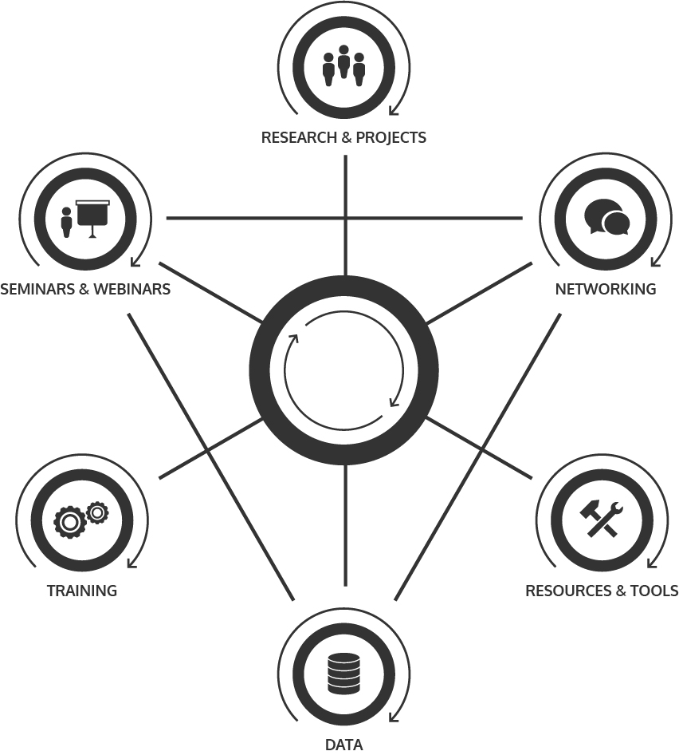
Our activities

Slide 7
Research & groups
Working groups
Academy group
Biodiversity & land use
Get the prices right
Government agency group
LCA data & methodology
LCA & vehicles
Social LCA
Nordic working group for Harmonization – LCA, climate and buildings
Expert groups
Environmental footprint
Data strategy
Projects
Swedish platform for the life cycle perspective
Modeling of Recycling
Nature Capital and Value Creation
SCOPES – Simplify Complexity of Environmental Scope declarations

Slide 8
On the agenda 2018-19 - Swedish Life Cycle Center & Swedish platform for the life cycle perspective
NOV
JAN
Hållbara livsstilar. 14-15/11
Webinar: Towards increased impact of life cycle information, Emma Rex. 25/11.
Webinar: Measures for resource efficiency and circularity, Anne-Marie Tillman. 17/1
DEC
FEB
JULY
Network conference, Stockholm 7/2.
Summary Report stage 8 + Annual Report.
Almedalen: Seminar. 30/6-7/7.
New agreement for Stage 9.
Many activities are able to take place thanks to the project Swedish platform for the life cycle perspective, funded by the Swedish Energy Agency.

Slide 9
380
life cycle professionals in the network

Slide 10
A value-adding partnership
Obtain tools and inspiration for new strategies and working processes to implement in your operations.
Benchmark the partners within the center.
Collaborate in joint research projects with academia, research institutes and partners in industry and authorities involved.
Increase your knowledge through close contact with other experts within the life cycle field.
Be highlighted as a frontrunner in sustainability. Your good examples, research or initiatives are communicated in the channels of Swedish Life Cycle Center.
Obtain access to high quality decision support and a network of over 400 life cycle professionals.
Get involved in strategic development through your seat on the center Board.
Find new ways to manage long-term sustainability.
Use the web forum for close contact with partners.
Make a larger impact through joint efforts to influence national and international initiatives.

Slide 11
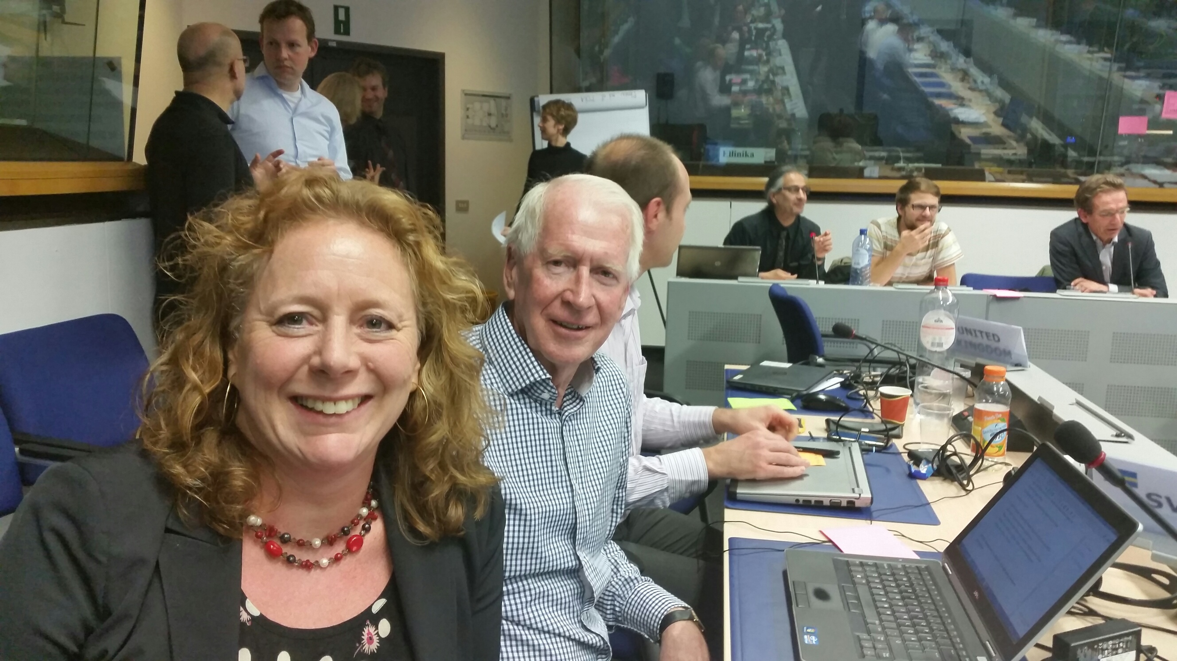
“Swedish Life Cycle Center sees beyond national and industrial borders. With its unique working groups, the center can affect the international development in the life cycle field.”
- Elin Eriksson, IVL Swedish Environmental Research Institute

Slide 12
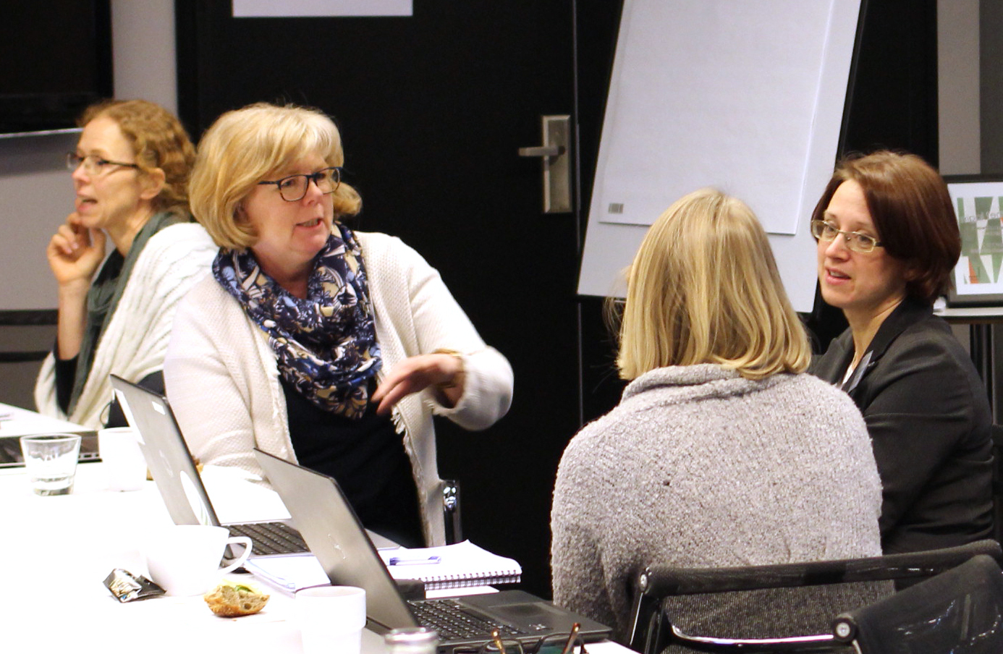
“With a lot of competence gathered in one network we can easier reach out with new research solutions and life cycle knowledge.”
- Susanna Widstrand, Swedish Energy Agency

Slide 13
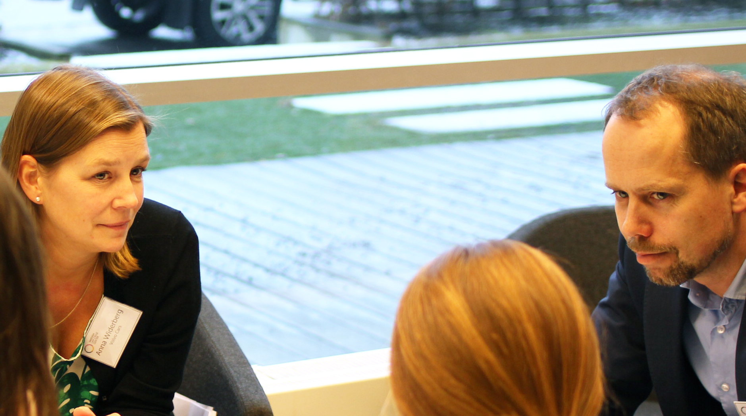
“The network has supported in many issues. When we discussed purchasing a new software solution for LCA, the center’s partners were there to give advice and share experience.”
Anna Widerberg, Volvo Cars

Slide 14
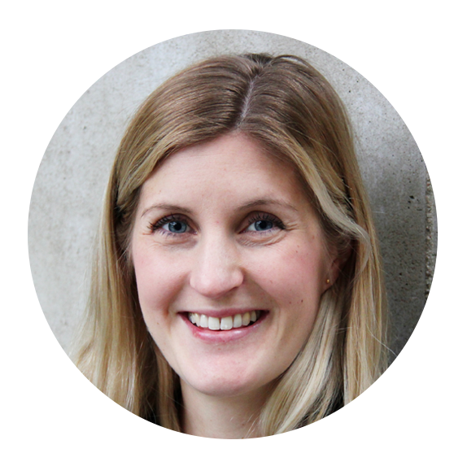
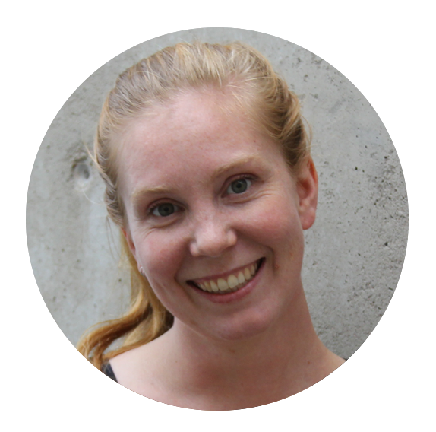
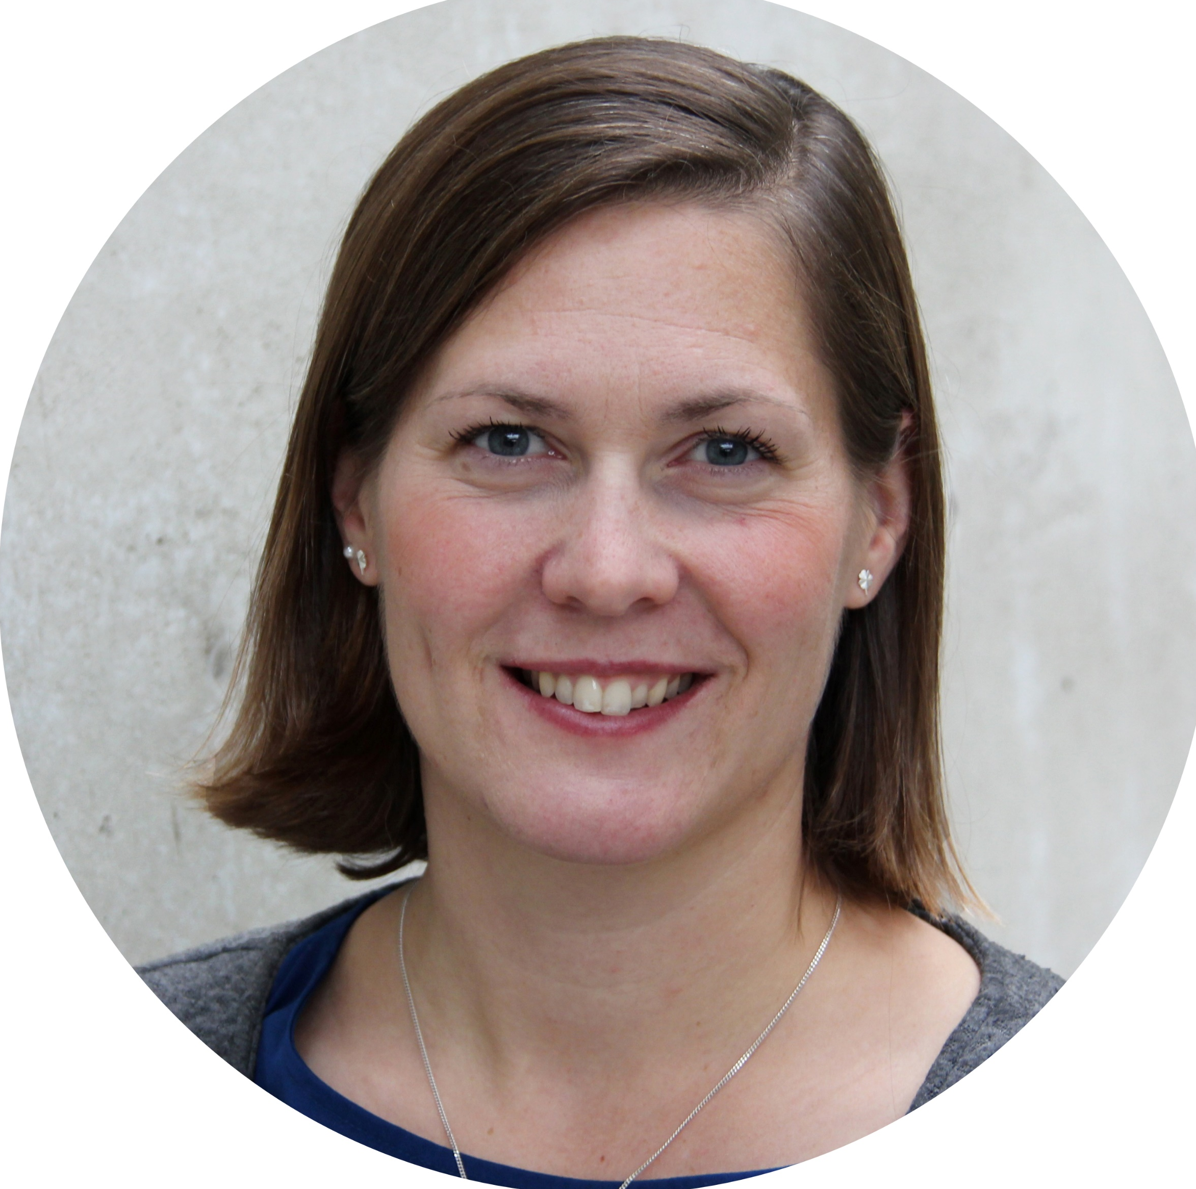
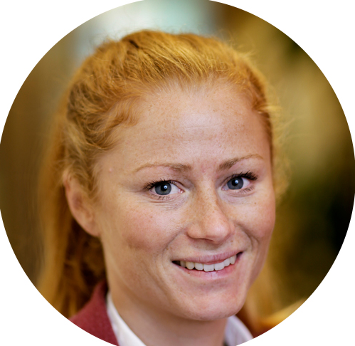
Thank you!
www.lifecyclecenter.se
Twitter: @lifecyclecenter
LinkedIn: Swedish Life Cycle Center
Director (parental leave)
Sara.palander@chalmers.se
Project Manager
Anna.wikstrom@chalmers.se
Project Manager
Jenny.lagergren@chalmers.se
Project Manager
Maria.rydberg@chalmers.se

